Slide 1
MODULE 7 – INTRODUCTION TO Arduino boards
Dr. P. Nirmala
Assistant Professor, Sr. Gr. I,
SENSE,
VIT Chennai Campus.

Slide 2
Quark SoC Processor

Slide 3
System on chip (Soc)
It is an IC that integrates all or most components of the computer in a single chip
It includes a CPU, I/O ports and storage
It also contains DACs, ADCs, radio frequency signal processing
High performance SoCs are usually integrated with external memory and secondary storage chips layered on top of SoCs
This is called PoP (Package on Pakage)

Slide 4
Difference between SoC and motherboard
SoCs integrate all of these components in a single IC
SoCs integrate CPU, graphics, memory interfaces, hard disk, USB connectivity, RAM, ROM and secondary memory on a single IC
Motherboard houses detachable components
Motherboards connect these components as discrete components or expansion cards

Slide 5
Applications
SoC integrates microprocessor/controller with highly advanced peripherals like graphics processing unit, WiFi modules, coprocessors etc.
SoCs, when tightly integrated, improve performance and decrease power consumption
This comes at a cost of reduced replaceability
Applications: Mobile computing, Edge computing, Embedded systems, Internet of Things

Slide 6
Quark Soc processor
Intel Quark is an Embedded SoC intended for small mobile devices such as wearable computers.
It is one fifth of its counterpart Atom and uses 1/10th of its power.
It is a 32 bit x86 design based on Pentium chip
The Quark processor was introduced as a competition for ARM’s Cortex M RISK based processors which are already used in Google Glass etc, many mobile phones etc.

Slide 7
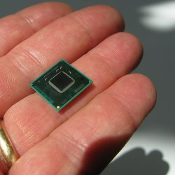
Intel Quark processor
Source: https://www.linux.com/news/will-intels-quark-run-linux/ as on 10 Oct 2020

Slide 8
continued
It is a line of 31-bit SoCs and microcontrollers by Intel
Specially for wearable devices since they have less power consumption
They support only embedded operating systems
It mainly was used to support the Intel Galileo microcontroller developer board.
Quark was introduced in 2013 and in 2016 Intel introduced Arduino 101 board that had Intel quark SoC

Slide 9
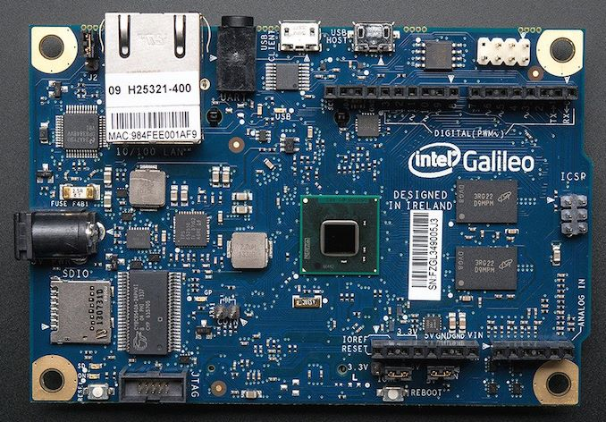
Intel Galileo using quark processor
Source: https://www.anandtech.com/show/13888/intel-discontinues-quark-socs-and-microcontrollers as on 10 Oct 2020

Slide 10
List of intel quark processors
Lakemont
Clanton
Silver Butte
Mint valley
Atlas Peak

Slide 11
What happened to quark Socs?
Intel Quark SoC x1000 contains a bug that causes crashing of the chip under certain circumstances
Segfault – A failure condition where the hardware intimates the OS that it is trying to access a restricted memory location.
The OS generally would send a signal to stop the process but here in Quark, it did not work
It caused a program crash and core dump

Slide 12
continued
So Intel has decided to discontinue manufacturing of all its Quark SoCs and microcontrollers
The final orders were allowed to be made only till July 19.
But the orders will be shipped till July 2022.

Slide 13
Weblink
https://www.anandtech.com/show/13888/intel-discontinues-quark-socs-and-microcontrollers

